Slide 1
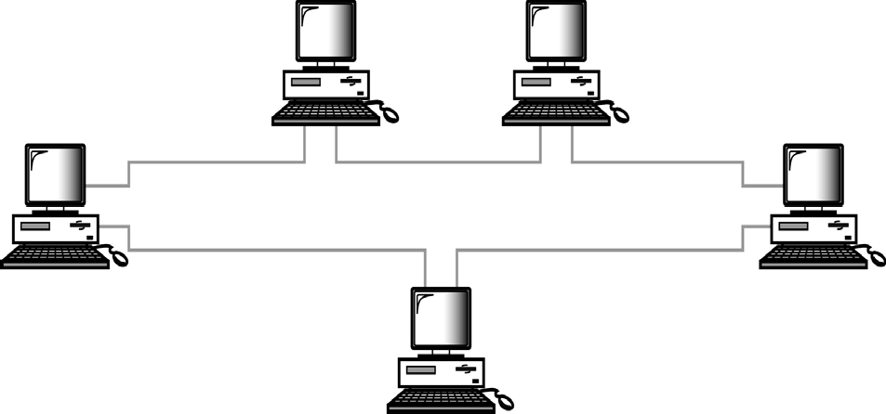

CS601-Data Communication
VU
LECTURE #6
Ring Topology
Ring Topology Diagram
Each device has point-to-point dedicated link with only two devices on either side
A signal is passed in the ring in one direction from device to device until it reaches its destination
Each device has a repeater incorporated
When a device receives a signal destined for another device, it regenerates the bits and pass them along
Advantages of Ring Topology
Easy to Install and Reconfigure
Only two connections to be moved to add or delete a device
SIMPLE Fault Isolation
Generally a signal is circulating at all times in a ring.
If one device does not receive a signal within a specified period, it can issue an alarm to tell network operator about the problem and its location
Disadvantages of Ring Topology
Unidirectional Traffic
A break in a ring I.e. a disabled station can disable the entire network
Can be solved by using:

Slide 2
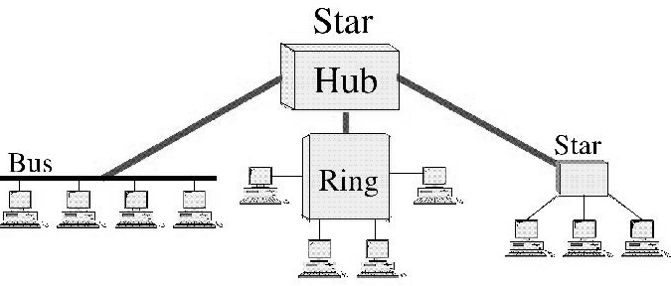
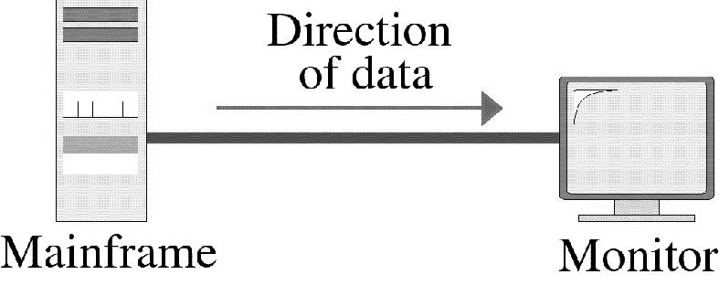
CS601-Data Communication
VU
Dual Ring or
A switch capable of closing off the Break
Hybrid Topologies
Hybrid Topologies
Several topologies combined in a larger topology
Example: One department of a business may have decided to use a Bus while other has a Ring
The two can be connected via a Central Controller in Star Topology
TRANSMISSION MODE
“Transmission Mode is used to define the direction of the signal flow between the linked
devices”
Transmission Modes
Simplex
Half-Duplex
Full-Duplex
SIMPLEX MODE
© Copyright Virtual University of Pakistan 34

Slide 3
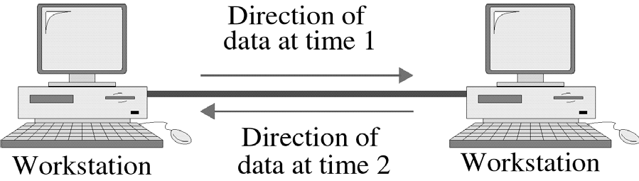
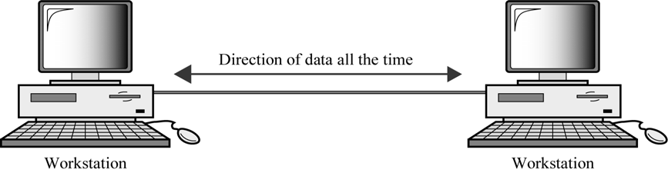
CS601-Data Communication
VU
Communication is Unidirectional
Only one of the two stations can transmit
Other can only receive
Examples: KEYBOARDS (Only Input), Monitors (Only Output)
Half – Duplex Mode
Each station can both transmit and receive but not at the same time
When one device is sending the other can only receive and vice versa
Lets understand the concept by using an example
One Lane Road with two directional traffic
When cars are traveling in one direction, cars going the other way must wait
Full Channel capacity is allocated to whatever entity that is transmitting at a specific time
Walkie Talkies
Full Duplex (Duplex)
Both stations can transmit and receive simultaneously
Two way street with traffic flowing in both directions at the same time
Signals traveling in either direction share the capacity of the link
o The sharing can take place in two ways:
© Copyright Virtual University of Pakistan
35

Slide 4
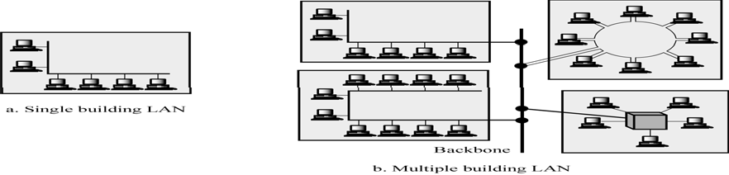
CS601-Data Communication
VU
Either the link must contain two physically separate transmission paths:
One for sending and
One for receiving
Capacity of the channel is divided between signals traveling in opposite directions
EXAMPLE
–Telephone Network
When two people are communicating via a telephone line, both can talk and listen at the same time
Categories of Networks
There are three main categories of Networks:
LANS
WANS
MANS
Into which category a network falls is determined by its SIZE, OWNERSHIP, DISTANCE IT COVERS, and its PHYSICAL ARCHITECTURE
LANS
A LAN is usually Privately owned and Links the devices in a single office, Building or a campus
Two Implications
Care must be taken in choice of a LAN, because there may be a substantial capital investment for purchase and maintenance.
Secondly, the network management responsibility falls solely on the user/company
Size of a LAN
Size of a LAN depends upon the Needs of Organization and the Type of Technology
LAN can be as simple as two PCs and a printer in someone’s home office or it can extend throughout a company and include complex equipment too
Currently LAN size is limited to a few kilometers
o Design of a LAN
36

Slide 5
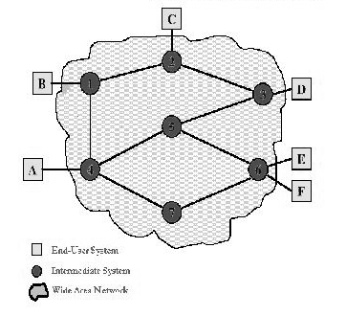
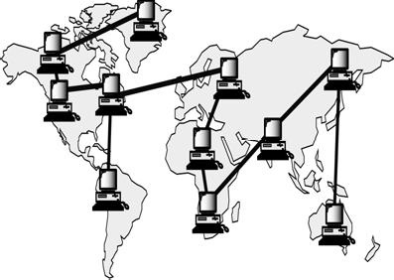
CS601-Data Communication VU
LANs are designed to allow resources to be shared between personal computers or workstations
The resources to be shared can include hardware (printer), software (an application program) or data.
Example of a LAN
A common example of a LAN found in many business environments links a work group of task related computers, for example engineering workstations or Accounting PCs. One of the PCs may be given a large capacity disk and becomes a server to others. Software stored on the server and is used by the whole group. In this case size is determined by software licenses
Transmission Media & Topology
In addition to size, LANs are distinguished from other types of networks by Transmission media and topology
In general a given LAN will use only one type of Transmission medium
The most common LAN topology Bus, Star Ring
Data Rates in a LAN
Traditionally 4 – 16 Mbps
Speeds increased and now 100Mbps and above are also possible
Giga Bit LAN technologies
WANs
Generally cover a large geographical area and it usually span an Unlimited number of miles by utilizing Public or Leased networks instead of having their own hardware as in the case of LANs
Design of a WAN
Typically , it consists of a large number of Switching Nodes
Transmission from any one device is routed through these internal nodes to the specified destination device
These nodes are not concerned with the content of the data, rather their purpose is to provide a switching facility that will move the data from node to node until it reaches its destination
How to Implement a WAN?
Traditionally WAN s have been implemented using one of the 2 technologies:
–Circuit Switching
–Packet Switching
Frame Relay and ATM Networks play important role nowadays too
37

Slide 6
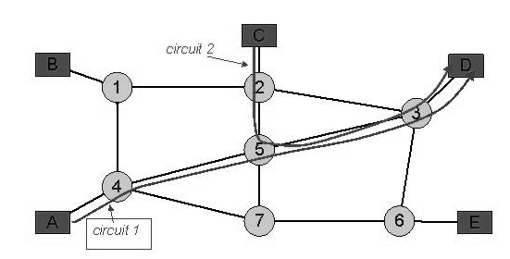
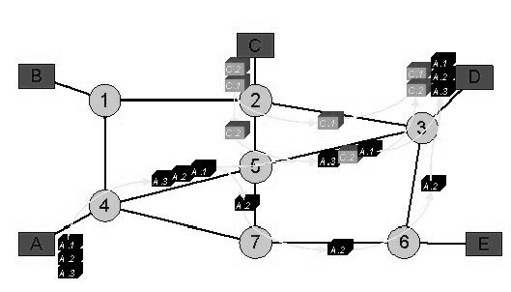
CS601-Data Communication
VU
Circuit Switching
A dedicated communication path is established between two stations through the nodes of the network
This path/CAPACITY stays up for the duration of the communication Example is Telephone Network
Packet Switching
No capacity is dedicated along a path through the network
Data Is sent out in small chunks called “Packets”
Each path is passed from node to node
At each node, entire packet is received, stored briefly and then transmitted to the next node.
Example is : Computer to Computer Communication
Frame Relay & ATM
Overhead bits for Error Protection are removed
10’s of 100’s of Mbps and also Gbps is possible
Summary
The OSI Model
Layered Architecture
Encapsulation and Decapsulation
Physical Layer
Data Link Layer
Reading Sections
Section 2.4,2.5, “Data Communications and Networking” 4th Edition by Behrouz
Forouzan
Sections 1.3, “Data and Computer Communication” 6th Edition by William Stallings

Slide 7
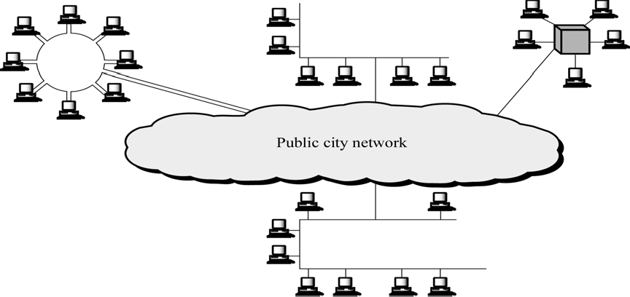
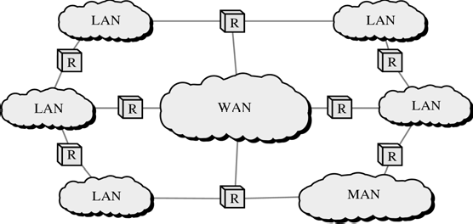
CS601-Data Communication
VU
LECTURE # 7
Metropolitan Area Networks
o Designed to extend over an entire city
It may be a single network e.g. Cable TV Network
Or
Interconnection of a No. of LANs into a larger network
Example: A company can use a MAN to connect the LANs in all of its offices throughout a city
Internetworks
When two or more networks are connected they become an internetwork or internet
Individual networks are joined together by the use of Internetworking Devices like Routers, Gateways etc.
internet: Combination of Networks
Internet: Specific World wide Network
The OSI MODEL
International Standards Organization (ISO) 1947
Multinational body dedicated to worldwide agreement on International Standards

Slide 8
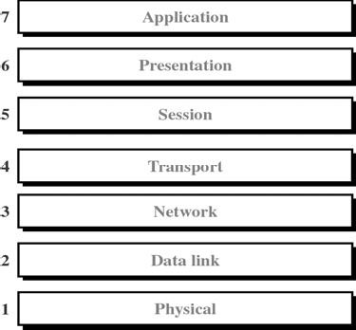
CS601-Data Communication VU
An ISO Standard that covers all aspects of Network Communication is Open System Interconnection Model (OSI)
Open System: A model that allows two different systems to communicate regardless
of their underlying network
Vendor –Specific Models close off communication
Purpose of the OSI MODEL
Open Communication between different systems without requiring changes to the underlying hardware and software.
OSI Model is not a Protocol. It is a model for understanding and designing a network architecture that is flexible, robust and interoperable
Definition of the OSI MODEL
A layered framework for the design of network systems that allows communication across all types of computer systems regardless of their underlying architecture
Layers of the OSI Model
Physical (Bits)
Data Link (Frames)
Network (Packets)
Transport (Segment)
Session (Dialog units)
Presentation (Raw Data)
Application (Text, Numbers)
Please Do not Touch Steve’s Pet Alligator
40

Slide 9
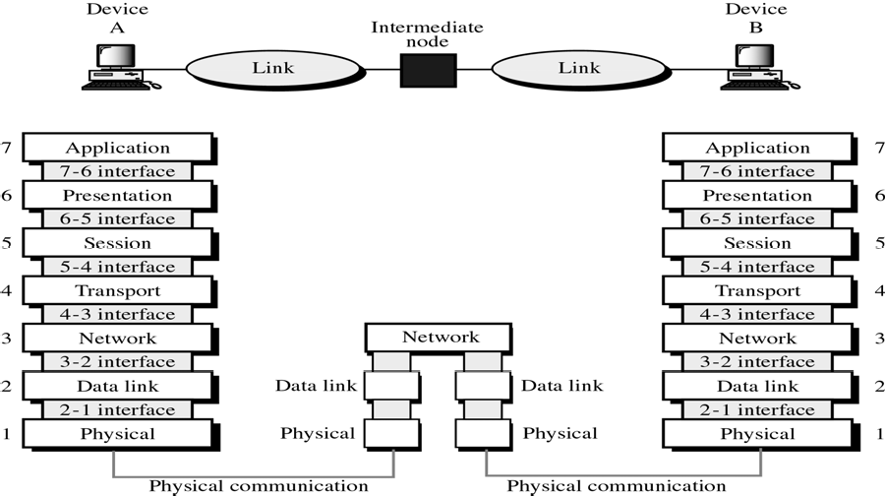
CS601-Data Communication
VU
What happen when a message travels from device A to Device B?
As the message travels from A to B , it may pas through many intermediate “Nodes”
These nodes usually involve only the first three layers of the OSI Model
In developing the OSI model, designers identified which networking functions had related uses and collected those functions into discrete groups that became the layers
Each layer defines a family of functions distinct from other layers
By defining and localizing functionality in this fashion , the designers created an architecture that is both comprehensive and flexible
The OSI model allows complete transparency b/w otherwise incompatible systems
Peer-to-Peer Processes
Within a single machine, each layer provides services to the layer above it and all upon the services from the layer below it.
For example Layer 3
Between machines, layer x on one machine communicates with layer x on the other machine.
The communication is governed by Protocols
The processes on each m/c that communicate at a given layer are called Peer –to peer processes
Headers and trailers
Control data added to a data parcel
Sender appends header and passes it to the lower layer
Receiver removes header and passes it to upper layer
Headers are added at layer 6,5,4,3,2. Trailer is added at layer 2

Slide 10
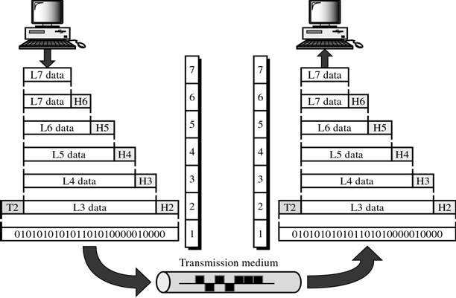
CS601-Data Communication
VU
Passing of data and network information down through the layers of sending machine AND Back up through the layers of the receiving machine is made possible by an
INTERFACE
Each interface defines what information and services a layer must provide for the layer above it
Interface provides MODULARITY
Each layer works as a separate module
Any modification or replacements can be made without changes in surrounding layers
Organization of Layers
Network Support Layers
–Deals with the Physical aspect of moving data from one device to another
–Layers 1, 2, 3
User Support Layers
–Allows interoperability among unrelated software systems
–Layers 5, 6, 7
Organization of Layers
Layer 4
–Ensures end-to-end reliable transmission
Upper OSI Layers always implemented in Software
Lower Layers are a combination of software and hardware
Physical layer is mostly Hardware
The OSI Model

Slide 11
CS601-Data Communication
VU
Summary
Categories of Networks (MANs)
Internetworks
The OSI Model
Reading Sections
Section 2.5, 3.1, 3.2 “Data Communications and Networking” 4th Edition by Behrouz A. Forouzan

Slide 12
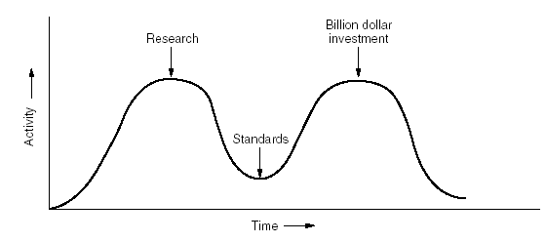
CS601-Data Communication
VU
LECTURE # 8
Critique of OSI Model
Reasoning for OSI not getting Widespread
Bad Timing(slide) (Apocalypse of Two Elephants)
–David Clarke of MIT
–If standards are written too early: subject is badly understood and bad standards
–If standards are written too late so many companies may have already made investments in doing the same thing with different other ways
Bad Technology
–Flow control, error control, addressing is multiple
–Session and Presentation(EMPTY), Network and DL(Full)
Bad Implementations
Apocalypse of Two Elephants
Physical (Layer 1)
Coordinates the functions required to transmit a bit stream over a physical medium
Deals with mechanical and electrical specifications of Tx. Medium and Interface
Also defines procedures and functions that physical devices and interfaces need to perform for TX. To occur (Figure)

Slide 13
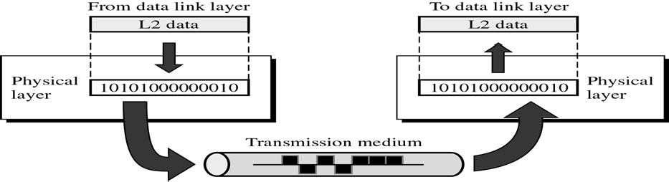
CS601-Data Communication
VU
Figure
Functions of Physical Layer
Physical Characteristics of Interface & Media
Defines characteristics of Interface b/w device and Tx Medium
Interface is a plug gable connector that joins one or more signal conductors
Also defines the type of transmission medium
Representation of Bits/Encoding
The physical layer data consists of a stream of bits (sequence of 1’s and 0’s)
To be transmitted the bits must be ENCODED into signals: Electrical or Optical
Physical layer decides the type of ENCODING
Data Rate / Transmission Rate
Date Rate ( Bits per second) also decided by the Physical Layer
So , Physical layer defines the Duration of a Bit
Means how long will a bit last
Synchronization of Bits
Sender and Receiver must be synchronized at the bit level
Sender and Receiver clocks must be synchronized
It is done by Physical layer
Line Configuration
Physical Layer is also concerned with Line Configuration
Line Configuration represents the connection of device with the Medium
Point-To-Point or Multipoint
Physical Topology
Mesh, Star, Ring, Bus etc.

Slide 14
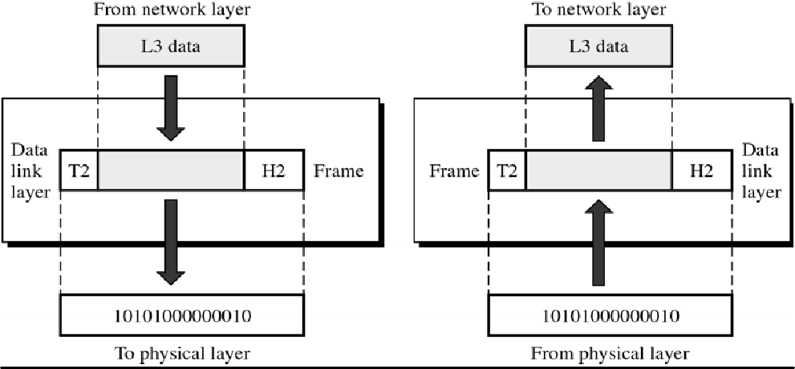
CS601-Data Communication
VU
Transmission Mode
Physical Layer also defines the direction of Transmission between the devices
Simplex. Half Duplex, Full Duplex
Data Link Layer (Layer 2)
Transforms physical layer which is raw transmission facility to a reliable link
Responsible for Node to Node Delivery
Makes physical layer look error free to the upper layer
Figure
Functions of Data Link Layer
Framing
The data link divides the stream of bits from Network layer into manageable data units called “FRAMES”. This process is known as Framing.
Physical Addressing
Frames need to be transmitted to different systems on a network
Data Link layer adds a HEADER to Frame
Header defines the physical address of sender(Source address) and/or receiver address (Destination address)
If frame is intended for a device outside the network, the receiver address is the address of the device that connects one network to the other
Flow Control
Data Link layer imposes Flow Control mechanisms to prevent overwhelming the receiver

Slide 15
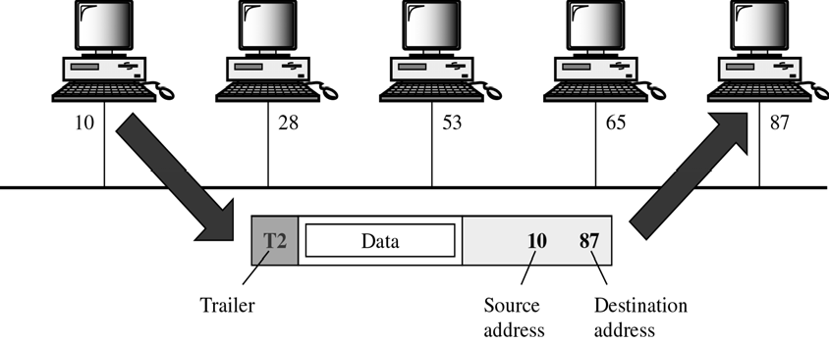
CS601-Data Communication
VU
Error Control
Data link layer adds reliability to physical layer by adding mechanisms to detect and retransmit lost or damaged frames
Also uses a mechanism to prevent duplication of frames
Error Control bits are added to the form in the TRAILER
Access Control
Two or more devices may be connected to a single link
Data link protocols are necessary to determine which device will have the control of the link at a given time
EXAMPLE
Node with physical address 10 sends a frame to a node with physical address 87
Two nodes are connected by a link.
At the DL level, this frame contains physical address in the Header, This is the only address needed at this level
Rest of header contains other info as needed
Trailer contains extra bits needed for error detection
NETWORK LAYER
❖
Responsible for Source-to-Destination delivery
DL Layer oversees the delivery of data between 2 systems on the same network
Network Layer ensures that each packet gets from its point of origin to its final destination
Node –to Node vs Source to Destination
If the two systems are connected to the same network, there is no need for Network layer and node –to node delivery is enough
If two systems are connected to two different networks, there is often a need for Source-to destination delivery

Slide 16
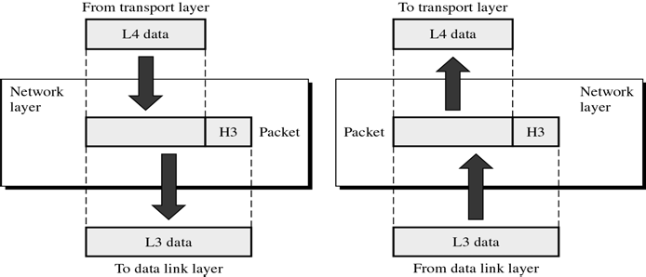
CS601-Data Communication
VU
Function of Network Layer
Logical Addressing
Physical addressing implemented by Data link layer handles addressing problem locally
If a packet is going from one network to another, we need another addressing system to help distinguish source & destination systems
Network layer adds Header to the data coming from upper layers that among other things include LOGICAL ADDRESS of the sender and receiver
Routing
When independent networks or links are connected together to create an “internetwork”, the internetworking devices route packets to their final destination
Routers are those internetworking devices
One of the functions of Network layer is to define this route
Example Network Layer
•We want to send data from a node with network address ‘A’ and physical address 10, located on one LAN to
•A node with network address P and physical address 95 located on another LAN
•Because the two nodes are present on two different networks, we cannot use physical address only
•We need a Network address that can pass us from the Network boundaries
•The packet therefore contains the logical address which remains the same from source to destination
•The physical address will change when packet moves from one network to the other
•The box with R is a Router
Summary
The OSI Model
Function of Layers
Reading Sections
Section 3.1,3.2, “Data Communications and Networking” 4th Edition by Behrouz
Forouzan

Slide 17
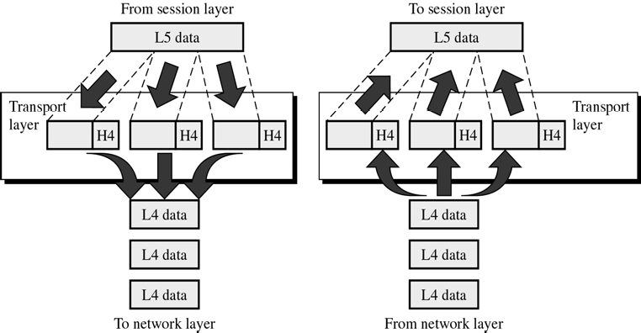
CS601-Data Communication
VU
LECTURE #9
Transport Layer
Responsible for Source-to-Destination delivery of Entire Message
Network Layer oversees source-to-destination delivery of the entire packets but it does not recognize any relationship b/w those packets
Network layer treats each packet independently
Transport Layer ensures that whole message arrives at the destination intact
Functions of Transport Layer
Service Point Addressing
Computers run several programs at the same time
Source-to-Destination delivery means delivery not only from only from one computer to the other but also from a specific process on one computer to a specific process on the other
Transport layer header includes a type of address called Service Point Address or PORT Address
Network layer each packet to the correct computer while Transport layer gets entire message to the correct process on that comuter
Segmentation and Reassembly
Message is divided into transmittable segments
Each segment contains a sequence number
These sequence no.s enable Transport layer at the receiving m/c to reassemble message correctly at the destination and to identify and replace lost packets

Slide 18
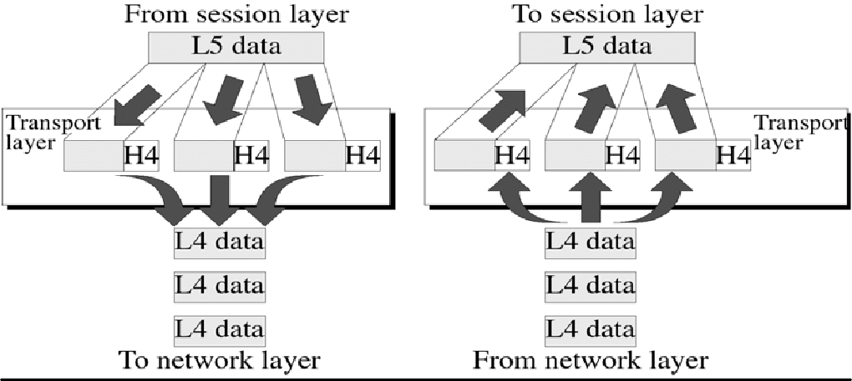
CS601-Data Communication
VU
Connection Control
Transport layer can be either connection-less or connection-oriented
Connectionless
Treats each segment as an independent packet and delivers it to the transport layer of the destination m/c
Connection-Oriented
A connection is established first with Transport layer before delivering the packet.
After all data is Tx. , the connection is disconnected
Flow Control
Like Data link layer, Transport layer is also responsible for Flow control
Flow control is performed end-to-end rather than across a single link
Error Control
Like data link layer, Transport layer is responsible for the Error Control
Error control is performed end-to-end
This layer makes sure that entire message reaches Rx Transport layer w/o error
Error can be a result of Lost, damaged or duplicated data and usually Re Tx is done
Example Figure
Session Layer
o Session layer is the Network Dialog Controller
o Establishes, Maintains, and Synchronizes
the interaction
between
communicating systems
50

Slide 19
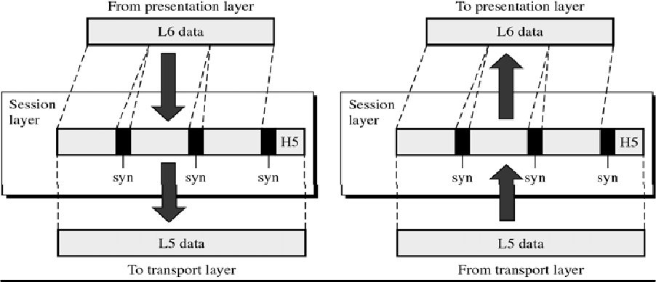
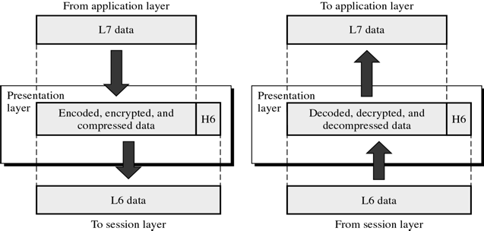
CS601-Data Communication
VU
Function of Session Layer
Dialog Control
Session layer allows two systems to enter into a dialog.
It allows communication between two processes to take place either in half duplex or full duplex mode
Synchronization
Session layer allows a process to add check points (synchronization points) in a stream of data
If a system is sending a file of 2000 pages, it is advisable to insert check points after every 100 page to ensure that each 100 page unit is received and acknowledged independently
In this case, if a crash happens during the transmission of page 523 , retransmission at page 501
Page 1-500 need not be retransmitted
Presentation Layer
o This layer is concerned with Syntax and Semantics of info exchange between two systems
Summary
The OSI Model
Functions of Layers
Reading Sections
Section 3.2 “Data Communications and Networking” 4th Edition by Behrouz A. Forouzan

Slide 20
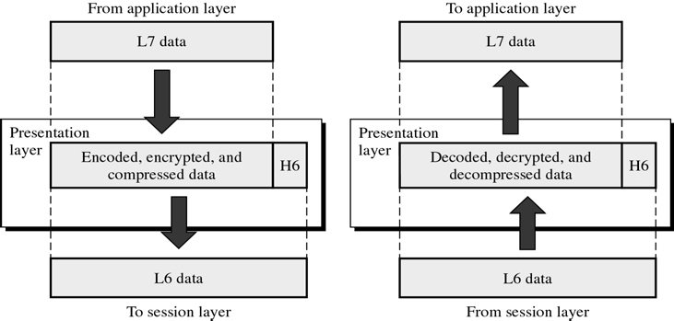
CS601-Data Communication
VU
LECTURE #10
Presentation Layer
o This layer is concerned with Syntax and Semantics of info exchange between two systems
Functions of Presentation Layer
Translation
The processes (running programs) in two systems are usually exchanging info in the form of character strings, numbers and so on…..
The info should be changed to bit streams before being transmitted
Because different computers use different ENCODING SYSTEMS, presentation layer is responsible for interoperability b/w these different encoding methods
The presentation layer at the sender changes the info from its sender- dependent format to the common format
The presentation at the receiver changes info from common to the receiver dependent format
Encryption
To carry sensitive info , a system must be able to assure privacy
Encryption means that sender transforms original info to another form and sends the resulting message out over the network
Decryption reverses the original process to transform message back to its original form
Compression
Data compression reduces the number of bits to be transmitted

Slide 21
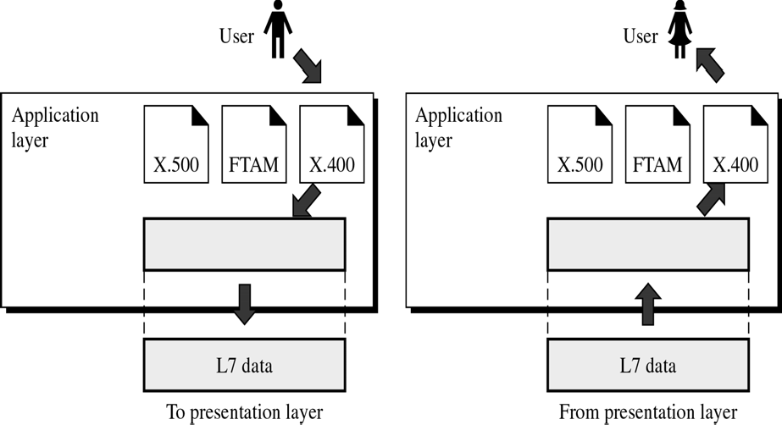
CS601-Data Communication
VU
Data compression becomes particularly important in transmission of multimedia such as text, audio and video
Application Layer
Enables the user either human or software to access the network
It provides user interface and support for the services such as Electronic mail, Remote File access and Transfer, Shared Database Management and other services
Application Layer Figure
o In the figure, of many application services available, only three services are shown
–X-400 (message Handling Services)
–X-500 (Directory Services)
–File Transfer, Access& Management (FTAM)
In this example user uses X-400 to send an e-mail message
No headers or trailers are added at this layer
Application Layer Functions
Network Virtual Terminal
NVT is a software version of a physical terminal and allows a user to log on to a remote host
To do so the application created emulation of terminal at the remote host
Users computer talks to the software terminal which in turn talks to the host
*& vice versa
Remote host believes it is communication with one of its own terminals and allow you to log on

Slide 22
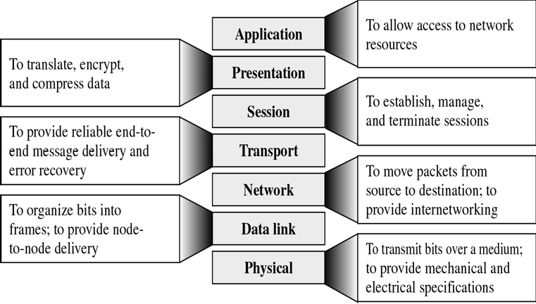
CS601-Data Communication
VU
File Transfer, Access & Manage.(FTAM)
This application allows a user to access file on the remote computers to make changes or read data
The purpose of this access is to Retrieve files from a remote computer and to manage or control files in that remote computer
Mail Services
This application provides the basis for email forwarding and storage
Directory Services
Provides distributed database sources and access for global info about various objects and services
Summary of Layer Functions
TCP/IP Protocol Suite
Transmission Control Protocol / Internetworking Protocol
Developed Prior to OSI Model
Widely used in the Internet Today
Layers in TCP/IP Protocol Suite
Physical (physical standards)
Data Link (N/w Interface)
Network (Interconnectivity)
Transport(Transport Functions)
Application(Session , Pres, app of OSI)

Slide 23
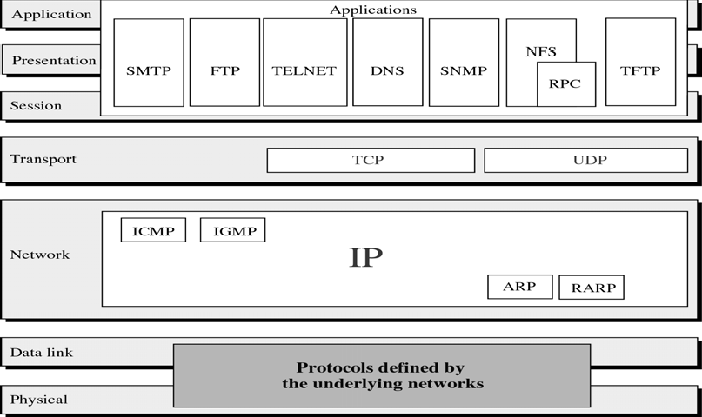
CS601-Data Communication
VU
TCP/IP Protocol Suite
Summary
*The OSI Model
*Functions of Layers
*TCP/IP Protocol Suite
Reading Sections
*Section 3.2, 3.3 “Data Communications and Networking” 4th Edition by Behrouz A. Forouzan

